Slide 1
Pose and Facial Expression Recognition on Multiple Yaw Angles
Presented By:
Richa Vinian IIT2015015
Payal Prasad IIT2015052
Puja Kumari LIT2015017
Samriddhi Niranjan LIT2015021
Under the Guidance of Prof. Anupam Agrawal

Slide 2
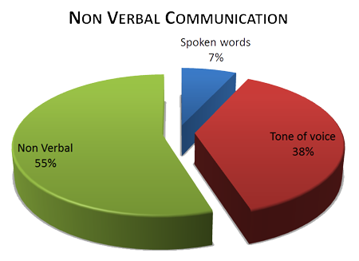
INTRODUCTION
Experiments in psychology suggest that Facial expressions convey 55% of the message in human interaction.
Also,emotion perception changes significantly with even a 15 degrees head pose change.

Slide 3
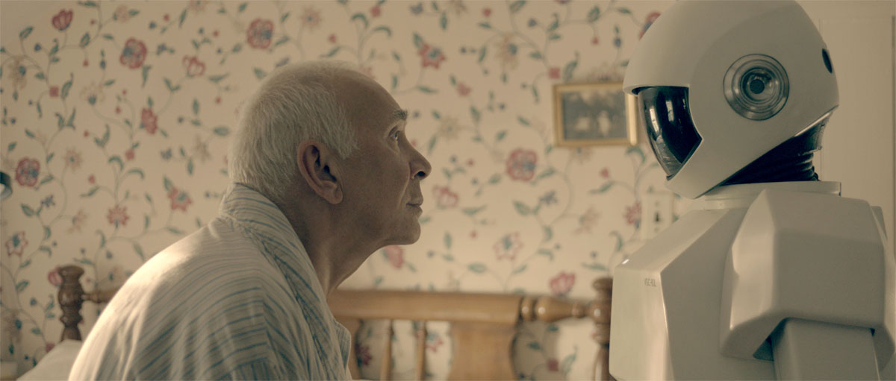
Rapid technological advancements have increased human computer interaction. .
computers that are able to interact naturally with the user, in the same way that humans interact with other humans , are taking the interest of researchers all across the world.

Slide 4
MOTIVATION
Pose is one constraint that has largely been unexplored.
Attempts to produce pose invariant facial expression classifiers have only considered yaw variations of up to 45 degrees.
In case of NON-FRONTAL facial expression recognition, little to moderate accuracy have been observed till date.

Slide 5
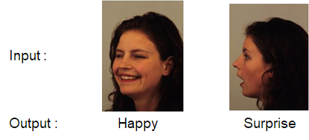
Problem Statement
Make a software system which takes an image of human face as an input and gives the expression and pose of the of the face as output and compare different approaches.
The input image may or may not be a frontal view of the face.
The output given by the system must be one of the following expressions: happy, surprise, anger, fear, sadness and disgust; and one of the three yaw angles: zero, forty five and ninety.
Forty-five Ninety

Slide 6
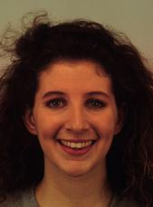
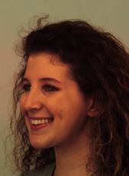
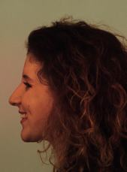
SCOPE
We plan to train the software to work on facial orientations of yaw angle 0, 45 and 90 degrees.
.
We plan to use LGBP and DCLBP for feature extraction of facial images.
0 yaw angle 45 yaw angle 90 yaw angle

Slide 7


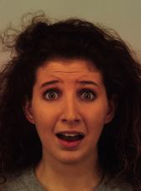


SCOPE
Images will be classified into 6 basic human expressions.
.
.
The training and testing have to be performed on individual face images.
We compare the result of expression recognition with and without pose classification.
Sad Disgust Fear Happy Angry Surprise

Slide 8
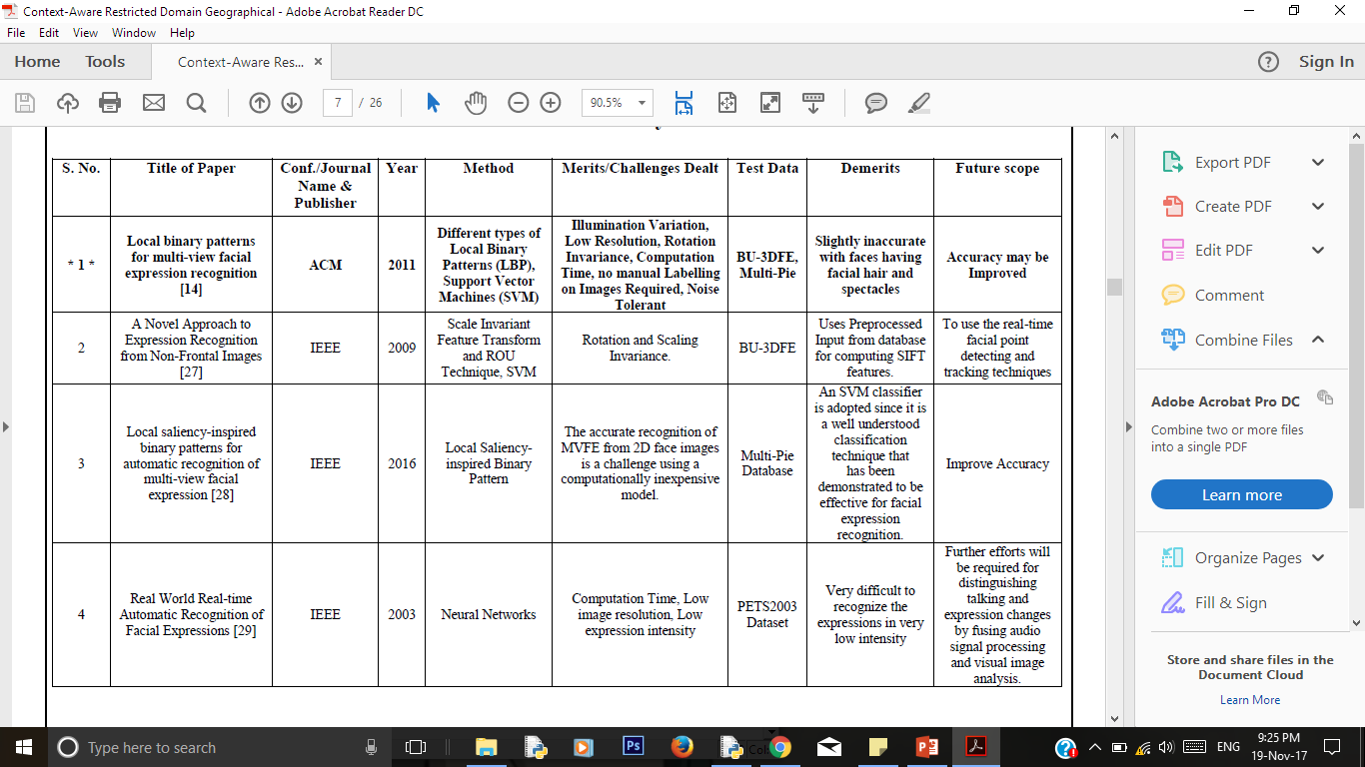
Literature Survey

Slide 9
Approach

Slide 10
Our approach involves two basic steps:
Feature Extraction
Classification
Feature Extraction
LGBP without angle classification
LGBP with angle classification
Diagonal Criss-Cross Local Binary Pattern (DCLBP)
Classification
SVM

Slide 11
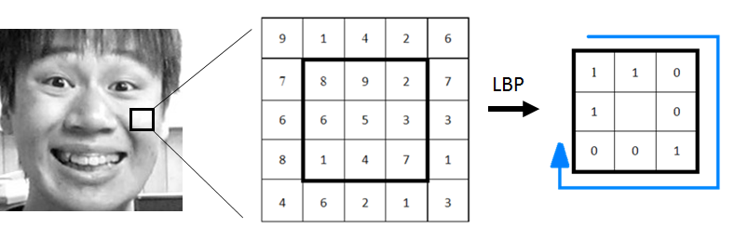
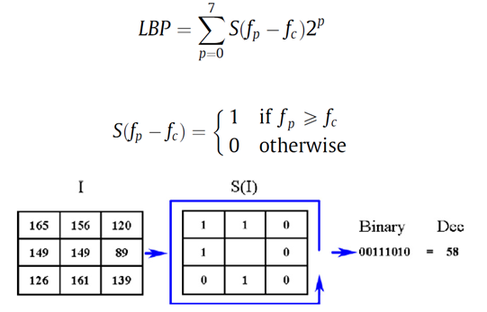
LOCAL BINARY PATTERN
Visual descriptor used for classification in computer vision.
Histogram of the image is obtained after applying LBP.
Number of bins in the histogram is 256.

Slide 12
LOCAL BINARY PATTERN
The LBP feature vector, in its simplest form, is created in the following manner:
Division of the examined image
into cells .
For each pixel in a cell, comparison
of the pixel to each of its 8 neighbors.
Calculation of 8-digit binary number
Compute the histogram,
over the cell.
256-dimensional feature vector.

Slide 13
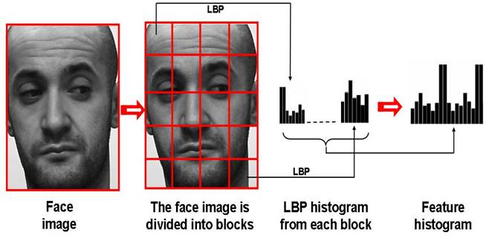
LOCAL BINARY PATTERN
Concatenation histograms of all cells. This gives a feature vector for the entire image.

Slide 14
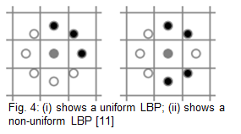
UNIFORM LOCAL BINARY PATTERN
It is a LBP which contains at most two bitwise transitions from 0 to 1 or vice versa for a circular binary string.
It was found that more than 90% of all the LBPs are uniform in an image.
Uniform LBP reduces the histogram size from 256 to 59 because only 59 such patterns exist for a 8-bit vector.

Slide 15
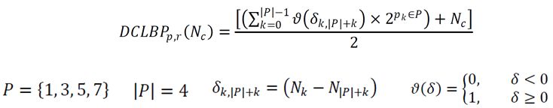
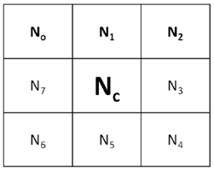
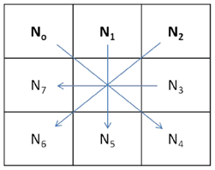
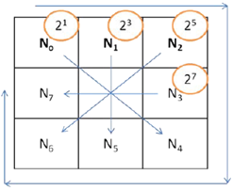
DIAGONAL CRISS-CROSS LOCAL BINARY PATTERN

Slide 16
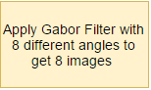
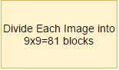
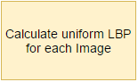
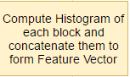
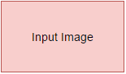
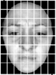
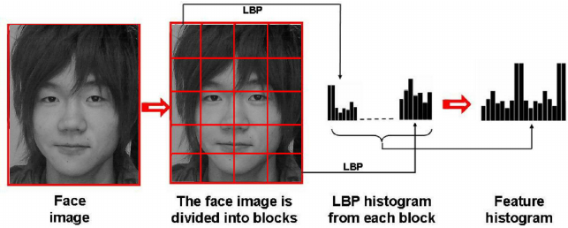

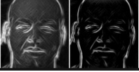
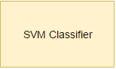

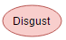
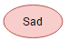
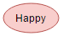
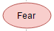
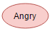
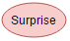
Method 1: LGBP Without Angle Classification

Slide 17
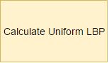
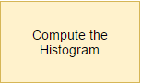
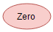
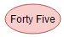
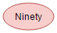
Method 2: LGBP With Angle Classification
for angle prediction

Slide 18
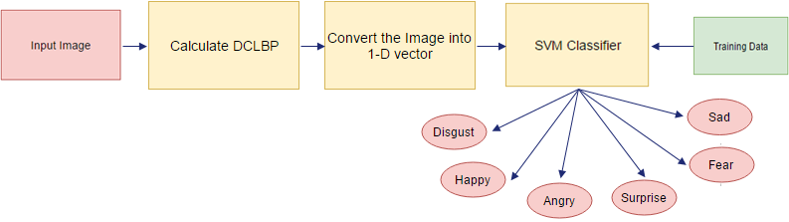
Method 3: Diagonal Criss-Cross LBP

Slide 19
Results and Analysis

Slide 20
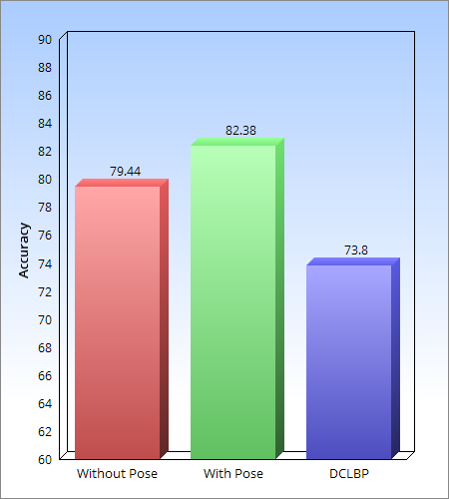
Comparison of Accuracy
The graph shows the comparison between accuracies of the methods
.
The method of LGBP with Angle Classification performs the best.
Fig : Bar chart showing accuracy comparison of With Pose, Without Pose LGBP and DCLBP

Slide 21
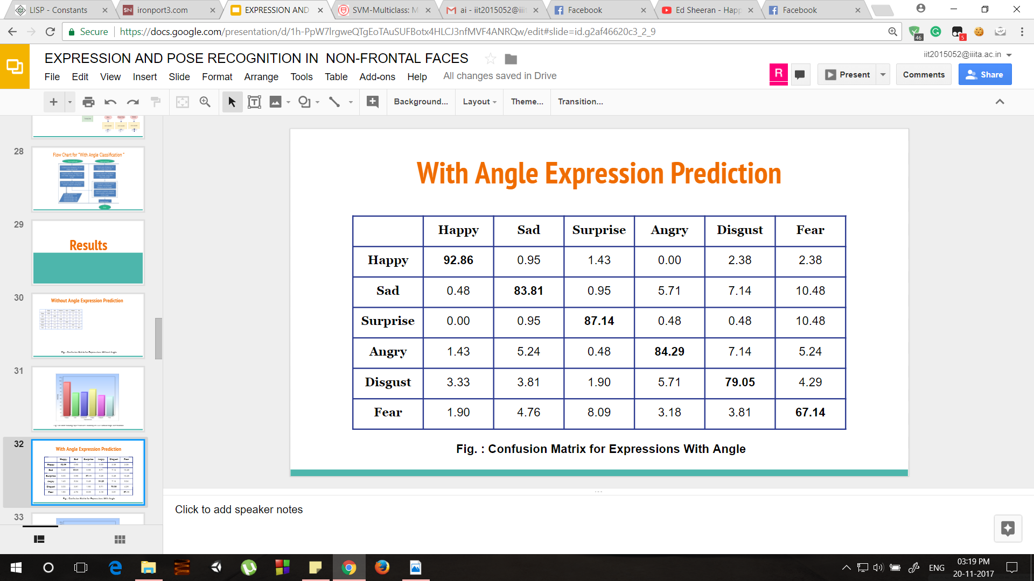
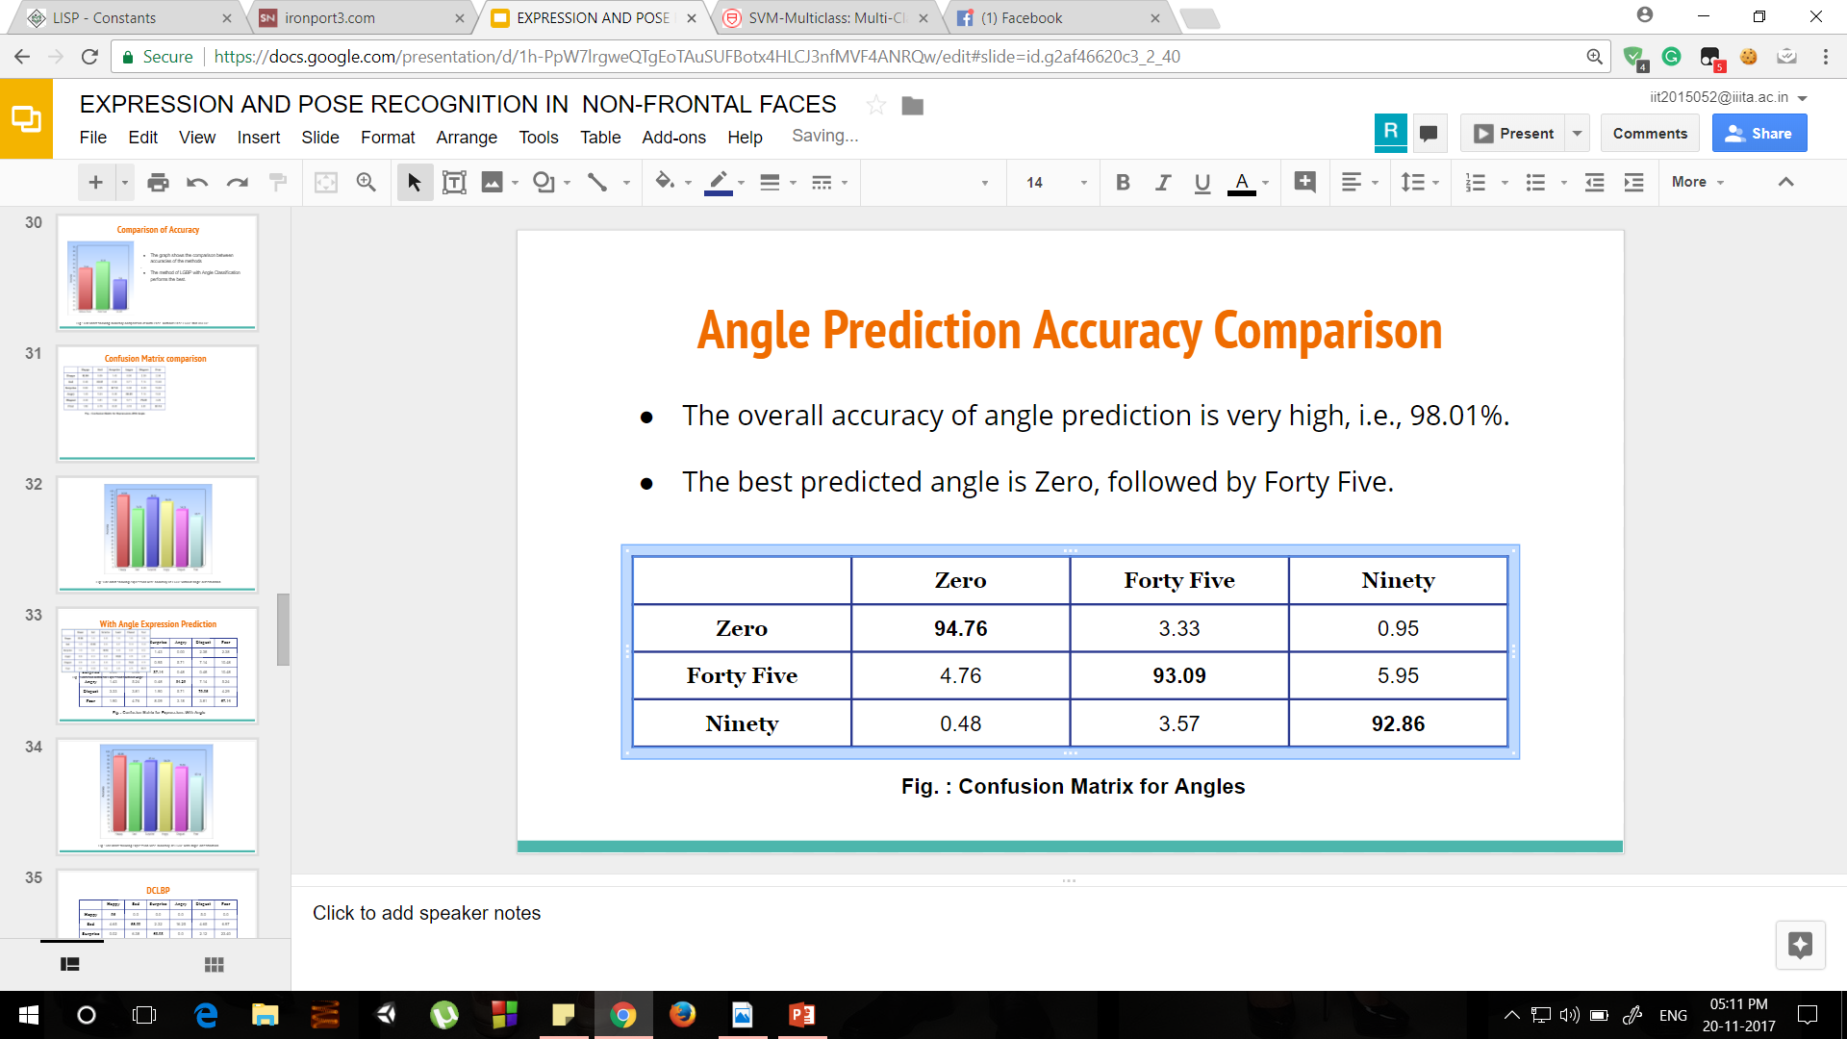
Confusion Matrix of LGBP with angle prediction
Inferences:
The overall accuracy for angle prediction is very high (93.57).
The best performing angle is “Zero” followed by “Forty Five”
The best performing expression is “Happy” followed by “Surprise”
“Fear” expression has the least accuracy due to its similarity with “Surprise” expression.
Fig. : Confusion Matrix for Angles

Slide 22
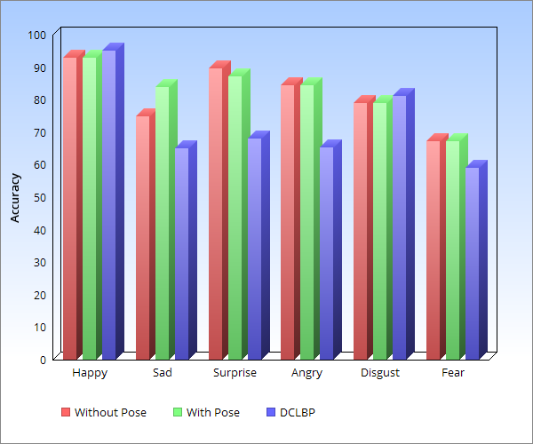
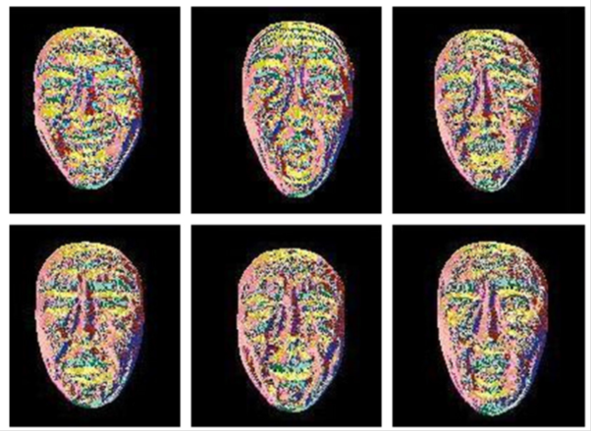
Expression-wise Comparison of Accuracies
Expression “Happy” has performed well in all the three approaches and the difference among accuracies is quite low.
“Fear” expression has performed the poorest in all the three approaches.
“Happy” and “Surprise” have consistently high recognition rates due to the distinctive deformation of facial features.
Fig : Bar chart showing expression-wise accuracy comparison of With Pose and Without Pose LGBP

Slide 23
Results on Own Dataset
The results after applying Method 2 on our dataset are as follows:
(i) Accuracy for Angle Classification: 70.53%
(ii) Accuracy for Expression Classification: 38.17%
Reasons for low accuracy than benchmark dataset:
Less Images.(About 1/4th the size of KDEF database)
Less Images Quality since they were clicked manually.

Slide 24
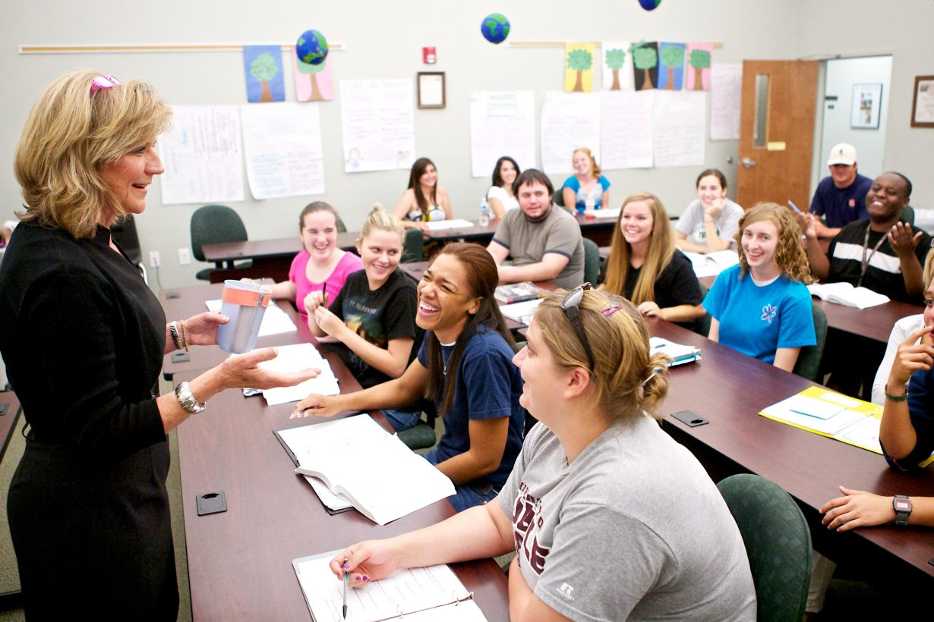
Real Life Applications
CLASSROOM ENVIRONMENT ANALYSIS SYSTEM
Can be used as a feedback and analysis system in Classrooms.
A good alternative to the traditional feedback system.

Slide 25

- Change song accordingly

Slide 26


Slide 27
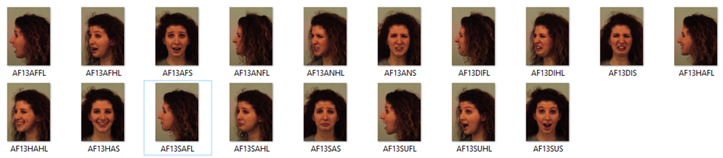
Datasets
Karolinska Directed Emotional Faces (KDEF) Database: Total Subjects: 140 (70 Male, 70 Female). Number of Expressions: 6 (Happy, Sad, Surprise, Anger, Disgust, Fear) Angles: 0, 45, 90 degrees. Total Images: 2520.
Fig : Sample Images from KDEF Dataset

Slide 28

Self Created at IIIT Allahabad: Total Subjects: 41 Number of Expressions: 6 (Happy, Sad, Surprise, Anger, Disgust, Fear) Angles: 0, 45, 90 degrees. Total Images:738
Fig : Sample Images from IIITA Dataset

Slide 29
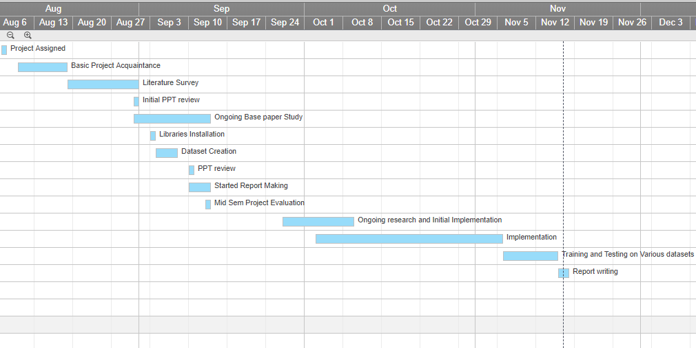
Activity Time Chart

Slide 30
Requirements
Hardware: •Processor: Intel Core i7 CPU @ 2.60 GHz •RAM: 6 GB
Software:
•Implementation Language: Python 3.5
•Libraries: NumPy, OpenCV3, PIL, Scikit-learn
•IDE: Anaconda (conda), Spyder

Slide 31
References
[1] S. Moore and R. Bowden, "Local binary patterns for multi-view facial expression recognition", Computer Vision and Image Understanding, vol. 115, no. 4, pp. 541-558, 2011.
[2] “Study on Co-occurrence-based Image Feature Analysis and Texture Recognition Employing Diagonal-Crisscross Local Binary Pattern”, Web: http://hdl.handle.net/10228/5282
[3] B. Santra and D. Mukherjee, "Local saliency-inspired binary patterns for automatic recognition of multi-view facial expression", in Image Processing (ICIP), 2016 IEEE International Conference on, 2016.
[4] S. Gong, P.W. McOwan, C. Shan, “Dynamic facial expression recognition using a bayesian temporal manifold model”, in: BMVC, vol. 1, 2006, pp. 297–306.
[5] S. Liao, W. Fan, A.C.S. Chung, D.Y. Yeung, “Facial expression recognition using advanced local binary patterns, tsallis entropies and global appearance features”, in: ICIP, 2006, pp. 665–668.
[6] C. Shan, T. Gritti, “Learning discriminative lbp-histogram bins for facial expression recognition”, in: Proceedings of the British Machine Vision Conference 2008.

Slide 32
Thank You

Slide 35
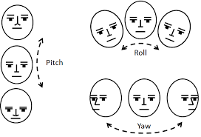
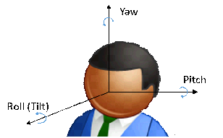
YAW ANGLE

Slide 36
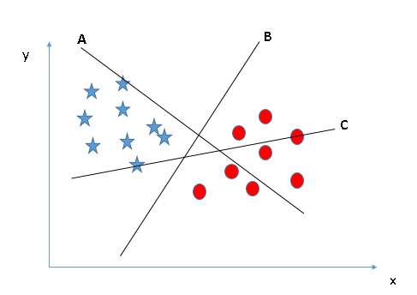
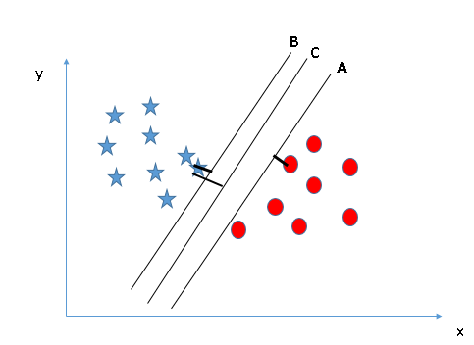
SVM
An algorithm in supervised machine learning used for classification.
Each data item is plotted as a point in n-dimensional space.
Classification is performed by finding the hyperplane that segregates 2 classes very well.

Slide 37
Use of Multiclass SVM
A single multiclass problem is reduced into multiple binary classification problems.
Method Used: One-versus-All
Involves building binary classifiers which distinguish between one of the labels and the rest.
In Method 2 (LBP with Angle Classification) , three One-vs-All classifiers have been trained for pose-dependent expression classification.

Slide 38
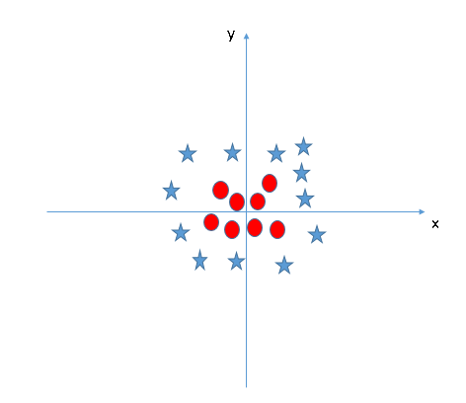

In the scenario below, we can’t have linear hyper-plane between the two classes, so how does SVM classify these two classes?
SVM solves this problem by introducing additional feature. Here, we will add a new feature z=x^2+y^2. Now, let’s plot the data points on axis x and z

Slide 39


Training Phase
Testing Phase

Slide 40

Flow Chart for “Without Angle Classification”

Slide 41
DCLBP
 | Happy | Sad | Surprise | Angry | Disgust | Fear
Happy | 95 | 0.0 | 0.0 | 0.0 | 5.0 | 0.0
Sad | 4.65 | 65.00 | 2.32 | 16.25 | 4.65 | 6.97
Surprise | 0.02 | 6.38 | 68.08 | 0.0 | 2.12 | 23.40
Angry | 4.34 | 10.86 | 4.34 | 65.21 | 6.52 | 8.69
Disgust | 0.00 | 5.40 | 2.70 | 8.10 | 81.08 | 2.70
Fear | 0.00 | 10.25 | 15.38 | 5.12 | 10.25 | 58.97

Slide 42

Fig : Bar chart showing expression wise accuracy of LGBP without angle classification.

Slide 43
With Angle Expression Prediction
 | Happy | Sad | Surprise | Angry | Disgust | Fear
Happy | 92.86 | 0.95 | 1.43 | 0.00 | 2.38 | 2.38
Sad | 0.48 | 83.81 | 0.95 | 5.71 | 7.14 | 10.48
Surprise | 0.00 | 0.95 | 87.14 | 0.48 | 0.48 | 10.48
Angry | 1.43 | 5.24 | 0.48 | 84.29 | 7.14 | 5.24
Disgust | 3.33 | 3.81 | 1.90 | 5.71 | 79.05 | 4.29
Fear | 1.90 | 4.76 | 8.09 | 3.18 | 3.81 | 67.14
Fig. : Confusion Matrix for Expressions With Angle

Slide 44

Without Angle Expression Prediction
Fig. : Confusion Matrix for Expressions Without Angle

Slide 45

Fig : Bar chart showing expression-wise accuracy of LGBP with angle classification.

Slide 46

Fig : Bar chart showing expression-wise accuracy of DCLBP

Slide 47
Angle Prediction Accuracy Comparison
The overall accuracy of angle prediction is very high, i.e., 98.01%.
The best predicted angle is Zero, followed by Forty Five.
 | Zero | Forty Five | Ninety
Zero | 94.76 | 3.33 | 0.95
Forty Five | 4.76 | 93.09 | 5.95
Ninety | 0.48 | 3.57 | 92.86
Fig. : Confusion Matrix for Angles

Slide 48

Flow Chart for “With Angle Classification ”

Slide 49

Fig : Bar chart showing angle prediction accuracy of UCLBP angle classification.

Slide 50
Accuracy of “Sad” expression is highest in LGBP with angle classification.
Accuracy of “Sad” expression is very low using DCLBP approach as compared to the other two approaches.
LGBP without angle classification outperforms LGBP with angle classification in “Surprise” expression

Slide 52

Activity Time Chart

Slide 53



